Slide 1

A Hybrid AI-Based Framework for
Reconstructing the Evolution of
Marathi from Sanskrit
Department of Information Technology
DOMAIN
AI & NLP
DURATION
BUDGET
AREA
Computational Linguistics
MMCOE · Karvenagar, Pune – 52
Notes:
Title slide. Introduce the team and context. Highlight that this is a seed-fund proposal for MMRPS.

Slide 2

Introduction & Motivation
Marathi at a Glance
The Problem
95+ million speakers worldwide
Official language of Maharashtra
Evolved from Sanskrit via Maharashtri Prakrit & Apabhraṃśa
Rich literary tradition dating back 1,000+ years
11th most spoken language globally
Historical transformations documented manually by scholars
No computationally grounded, explainable AI framework exists
Neural translation systems lack linguistic interpretability
Sanskrit–Marathi diachronic datasets are absent
Indic languages underrepresented in computational linguistics
Sanskrit
→
Prakrit
→
Apabhraṃśa
→
Marathi
Notes:
Explain that Marathi is a major Indo-Aryan language with a well-documented but entirely manual history of evolution. The core problem is the absence of an AI system that can reconstruct and explain this evolution.

Slide 3

Research Gaps
01
02
03
No Computational Framework
No Hybrid Model
Missing Datasets
No AI system models Marathi's diachronic evolution from Sanskrit
Transformer models lack linguistically grounded phonological rules
No curated Sanskrit–Marathi aligned lexical dataset for AI training
04
05
06
No Explainability
Semantic Drift Unmodeled
No Open Toolkit
Existing NLP outputs lack step-wise phonological transformation traces
Meaning shifts between Sanskrit roots and Marathi forms not captured
No open-source framework for Indic computational historical linguistics
Notes:
Seven key research gaps justify this project. Emphasize that the combination of hybrid modelling + explainability + Indic language focus is entirely novel.

Slide 4








Project Objectives
Design a hybrid architecture integrating rule-based phonology with Transformer neural modelling
Formally encode Sanskrit–Marathi phonological & morphological transformation rules (vowel shifts, schwa deletion, assimilation)
Develop phoneme-level modelling using IPA-based feature embeddings for structural sound-change learning
Construct a curated, aligned Sanskrit–Marathi diachronic lexical dataset
Model semantic drift between Sanskrit roots and Marathi derivatives using embedding-based similarity
Implement an explainability module generating interpretable, step-wise phonological transformation outputs
Evaluate using CER, Phonetic Edit Distance, BLEU/chrF scores + expert linguistic validation
Release an open-source computational historical linguistics toolkit for Marathi
Notes:
Eight objectives map directly to the research gaps. Walk through each one briefly, emphasizing the novel hybrid + explainable approach.

Slide 5
Proposed System Architecture
Linguistic Rule Encoding Layer
1
Formal computational encoding of historical phonological rules: vowel shifts, consonant simplification, schwa deletion, assimilation, morphophonemic alternations
Phoneme-Level Neural Modelling
2
Transformer architecture trained at phoneme level with IPA-based feature embeddings — learns structural phonetic evolution patterns, not surface orthography
Semantic Drift Modelling Layer
3
Contrastive representation learning captures semantic proximity and gradual meaning shifts between Sanskrit roots and Marathi derivatives
Explainability & Traceability Module
4
Generates interpretable step-wise transformation outputs showing intermediate phonological stages — transparent, not opaque neural predictions
INPUT: Sanskrit Root
OUTPUT: Reconstructed Marathi Form + Transformation Trace
Notes:
The four integrated layers are the core innovation. Emphasize layer 1 (rule encoding) + layer 4 (explainability) as the key differentiators from existing black-box approaches.

Slide 6
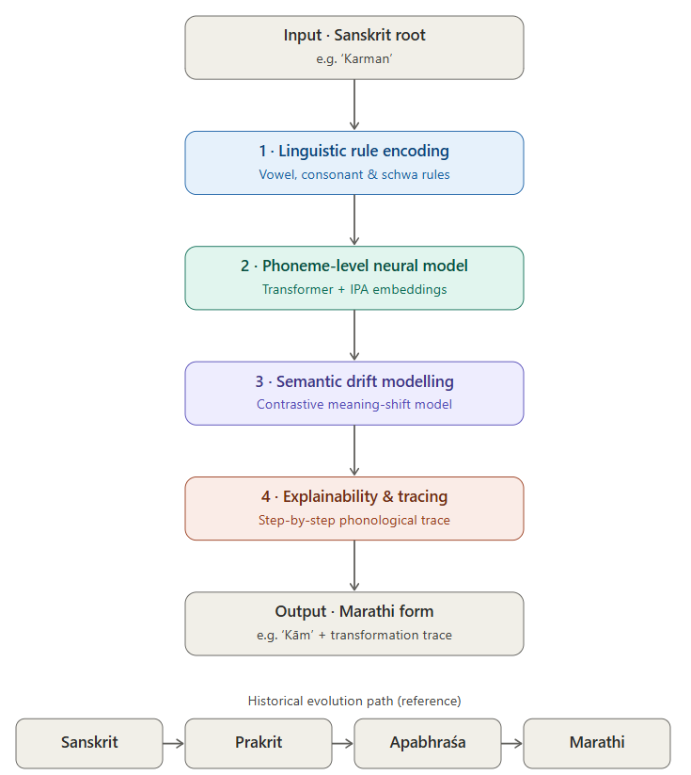
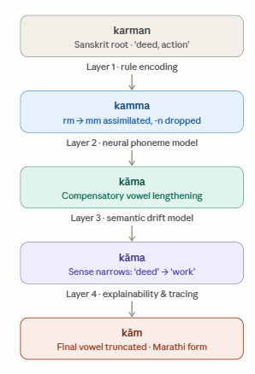
Flow Diagram
Example
Notes:
Seven phases over 12 months. Emphasize that Phase 4 (model development) is the longest at 4 months, reflecting the core technical challenge.

Slide 7

Methodology & Work Plan (12 Months)
1
2
3
4
5
6
7
8
9
10
11
12
Phase 1 · M1–M2
Literature Review & Data Collection
Phase 2 · M2–M3
Linguistic Rule Encoding
Phase 3 · M3–M4
Dataset Construction
Phase 4 · M4–M7
Model Development (Hybrid Transformer)
Phase 5 · M7–M9
Semantic Drift Modelling
Phase 6 · M9–M10
Evaluation & Linguistic Validation
Phase 7 · M10–M12
Deployment, Publication & Dissemination
Notes:
Seven phases over 12 months. Emphasize that Phase 4 (model development) is the longest at 4 months, reflecting the core technical challenge.

Slide 8
Expected Outcomes & Impact
Hybrid AI Framework
Diachronic Dataset
Explainability Module
Rule-aware Transformer model integrating phonological rules with neural sequence learning — first of its kind for Marathi
Curated Sanskrit–Marathi aligned lexical dataset released openly for the research community
Step-wise phonological transformation traces providing interpretable AI reasoning for historical linguistics
Quantitative Evaluation
Research Publications
Open-Source Toolkit
CER, Phonetic Edit Distance, BLEU/chrF + expert linguistic validation ensuring scientific rigor
≥1 paper in Scopus/SCI indexed journal + presentation at national/international conference
Documented toolkit for computational historical reconstruction of Indic languages, seeding future research
Notes:
Six deliverables map to tangible research outputs. The open-source toolkit is key for long-term impact on Indic NLP research.

Slide 9

Broader Impact & Contributions
Explainable AI for Low-Resource Languages
Computational Historical Linguistics
Advances XAI methodologies applicable to all Indo-Aryan languages, creating replicable models for linguistic communities worldwide
Establishes the first AI benchmark for Sanskrit–Marathi diachronic reconstruction, enabling systematic comparative studies
Digital Preservation of Indian Heritage
Educational Applications
Provides tools for restoring historical manuscripts, enabling digital humanities scholars to work at scale with AI assistance
Framework enables interactive language learning tools demonstrating the deep historical connections between Sanskrit and modern Marathi
Notes:
Three major research domains benefit: XAI, Computational Historical Linguistics, and Digital Preservation of Indian Heritage. Emphasize the scalability to other Indic language pairs.

